Slide 1

Capstone Project
Anand Rajan

Slide 2
Diabetes Prediction
Reducing the Effort needed to understand the problem.
A layman’s view of the problem and solution.
This presentation will take less than 10 minutes

Slide 3
Abstract
This project aims to study health and lifestyle information of an observed set of people and its correlation with diabetes. Using supervised machine learning techniques, we attempt to replicate the results as closely as possible, so that pre-emptive help can be offered to people not wishing to suffer this chronic and debilitating disease. The dataset is split into 2 parts, namely, training and testing data. After performing adequate exploratory data analysis on all features, we are able to extract interesting insights. Following this, we will attempt to teach a Machine Learning model how to arrive at a similar conclusion based on given information.

Slide 4
Introduction to Diabetes
Diabetes is the sixth leading cause of death in America today. Approximately 225,000 people die each year of diabetes complications. There are basically two types of diabetes. Type 1 is known as the childhood diabetes, but not necessarily limited to children. Type 1 diabetes is the more serious of the 2 types. People with this type require daily injections of insulin. Type 1 diabetes can appear suddenly to an individual who appeared to be otherwise healthy. Type 2 diabetes is often referred to as the adult diabetes. It is a metabolic disorder, non-insulin dependent. Type 2 develops slowly over time. Diabetes of either type can lead to other serious health problems. There is another type of diabetes known as type 3 that affects pregnant women. Even though found in pregnant women and can go away after birth, this type of diabetes can often lead to type 2 later in life. Each of these types of diabetes has one thing in common, that is high glucose levels in the blood.

Slide 5
Plan of the Project
We will study a dataset with all possible metrics and details, and will attempt to use 3 ML algorithms to accurately learn the patterns leading up to the subject’s diabetic status. This is a small, severely disproportionate and unbalanced dataset which could lead to learning difficulties as opposed to a larger dataset that contains balanced records of non-diabetic, pre-diabetic and diabetic people.
Steps followed:-
Source packages > Load dataset > Split dataset > Clean Dataset > Perform EDA > Correct discrepancies > Build models > Encapsulate program > Check usability > Document (out of control) corrections

Slide 6
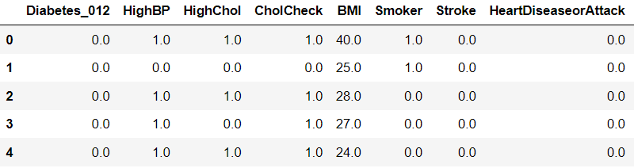
A preview of the dataset

Slide 7
Problems faced
Imbalanced data
Natural risks of bagging
Small dataset (and why it is not a top concern)

Slide 8
Thanks for watching
Please feel free to offer any constructive feedback!

